Slide 1
Microsoft Azure Architecting for Success: Building Optimized Workloads
Jonathan Vella Sr. Cloud Solution Architect
Microsoft

Slide 2
What is a Workload?
A "workload" or "application" is a resource or collection of resources that provide end-to-end functionality to one or multiple clients (humans or systems).
Another way to think of it; a workload is an end-to-end scenario (a process, a journey, a business operation) and the IT infrastructure supporting it.
It can be one or multiple applications, APIs and databases working together to deliver a specific functionality.

Slide 3

Why is being well-architected important?

Slide 4



Run Well-Architected cloud workloads— to create business value
Invest in these actions:
To avoid these consequences:
Manage budget
Improve workload security
Increase incident response
Streamline internal processes
Find costly mistakes
Enhance workload performance
Expenses, losses
Trust
Damages

Slide 5


What is the Well-Architected Framework?

Slide 6

Microsoft Azure Well-Architected Framework
Architecture guidance and best practices, created for architects, developers and solution owners, to improve the quality of their workloads, based on 5 aligned and connected pillars
Cost Optimization
Operational Excellence
Performance Efficiency
Reliability
Security
https://aka.ms/wellarchitected/framework

Slide 7

Building Well-Architected workloads— is a shared responsibility
Customer application
Customer app or workload, built on the Azure platform
Scope of Well-Architected
Assessments
Platform features
Optional Azure capabilities a customer enables – to ensure security, reliability, operability, performance
Platform foundation
Core capabilities built into the Azure platform – how the foundation is designed, operated, and monitored
Notes:
Building well-architected workloads is a shared responsibility.
Azure enables platform capabilities and features, but the customer must build well-architected workloads, with knowledge of their own architecture requirements.
Observe graphic on slide, and explain these points, from the bottom up:
Azure's hybrid model—with unified operational management control processes and governance management—offers multiple solutions, enabling customers to confidently deliver hybrid workloads.
Azure provides customers with the controls, methods, tools, and support
The customer brings a deep understanding of their goals, constraints, and requirements, along with knowledge specific to their industry.
Let's look at what it looks like to make tradeoffs in a business context.

Slide 8


Proven guidance to support the cloud journey
Meeting different persona needs at different altitudes
Central IT
Workload Owners
Portfolio
Landing zones
Cloud Platforms
Workloads
Assets
Define strategy
Define business justification and expected outcomes
Plan
Align actionable cloud adoption plan to business outcomes
Ready
Prepare process and environment for deployment
Adopt
Migrate or Innovate
Implement desired changes and deploy workloads
Govern
Comply, control and secure
Manage
Operate and optimize
Microsoft Cloud Adoption Framework for Azure
Azure Well-Architected Framework

Slide 9
Overcoming workload quality inhibitors
Cost Optimization | Operational Excellence | Performance Efficiency | Reliability | Security
No cost and usage monitoring Unclear on underused or orphaned resources Lack of structure billing management Budget reductions due to lack of support for cloud adoption by LT/board | Lack of rapid issue identification No deployment automation Absence of communication mechanisms and dashboards Unclear expectations and business outcomes No visibility on root cause for events | No monitoring new services No monitoring current workloads health No design for scaling Lack of rigor and guidance for technology and architecture selection | Unclear on resiliency features/capabilities for better architecture design Lack of data back up practices No monitoring current workloads health No resiliency testing No support for disaster recovery | No access control mechanism (authentication) No security thread detection mechanism Lack of security thread response plan No encryption process
Notes:
Sample list… many more

Slide 10
How I architect for success
Why, What, How.
DEFINE OUTCOMES
Understand key business outcomes
Capture functional and non-functional requirements (NFR)
Document KPIs for NFRs (e.g., TX/sec, concurrent users, scalability, security, compliance, resiliency, etc.)
Assess results, plan for ongoing optimizations
OPTIMIZE
ARCHITECT
Use the Azure Architecture Center to identify relevant ref. architecture/s
Build a cost guesstimate
Secure CxO commitment
BUILD
Build a Minimum Viable Product
Measure services & cost + identify risks

Slide 11
How we optimize existing workloads
GATHER
Collect data to identify optimization opportunities
Assess results, plan for ongoing optimizations
REVIEW
ANALYZE
Confirm optimization opportunities
ADVISE
Present and implement optimization recommendations

Slide 12
Best practices to drive workload quality
Cost Optimization | Operational Excellence | Performance Efficiency | Reliability | Security
Monitor and forecast Cost controls Azure Hybrid Benefit Reserve Instances Shutdown Resize Move to PAAS | DevOps Deployment Monitor Processes and cadence | Design for scaling Monitor performance | Define requirements Test with simulations and forced failovers Deploy consistently Monitor health Respond to failure and disaster | Identity and access management Infra protection App security Data encryption and sovereignty Security operations
Notes:
Some of topics covered in each of the pillars

Slide 13



It’s all about the trade-offs Business requirements influence workload architecture decisions
Dev/Test Workloads
Mission-Critical Workloads
Securing all Workloads

Slide 14

Delivering WAR to customers

Slide 15
Sample Customer Engagement Agenda
Kick Off
Data Analysis
Present
Introduction
Review recommendations
&
prioritize remediation actions
Understand workload and business priorities
Present final report
Workload overview
Implement or Enable Recommendations
Well-Architected Review & Advisor Score
Extract Advisor CSV
Draft reporting deliverables including solutions to discuss
Plan next phases
Well-Architected Review Scope (does not include remediation)

Slide 16
Estimated Effort
Stage | Details | Est. effort in Hrs.
01 | Introduction to Azure Well-Architected (Incl. sample outcomes & deliverables) | 2
02 | Workload Overview (Purpose / business function, compliance requirements, non-functional requirements, Azure environment, Architecture Diagram, etc.) | 2-3
03 | ALZ High-Level Review | 1-2
04 | Well-Architected Review and Advisor (Import Azure Advisor results before review; export review to CSV) | 3-5
05 | Review recommendations and prioritize (e.g., 5 P0, 3-5 P1, 3-5 P2) remediation actions based on both best practices & business requirements | 4-6
06 | Share draft with customer | 1
07 | Present final report to customer | 2
08 | Plan next phase based on stage 05 | 2-3

Slide 17
Well-Architected Resources

Slide 18
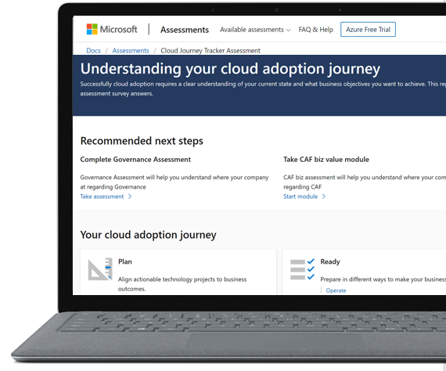
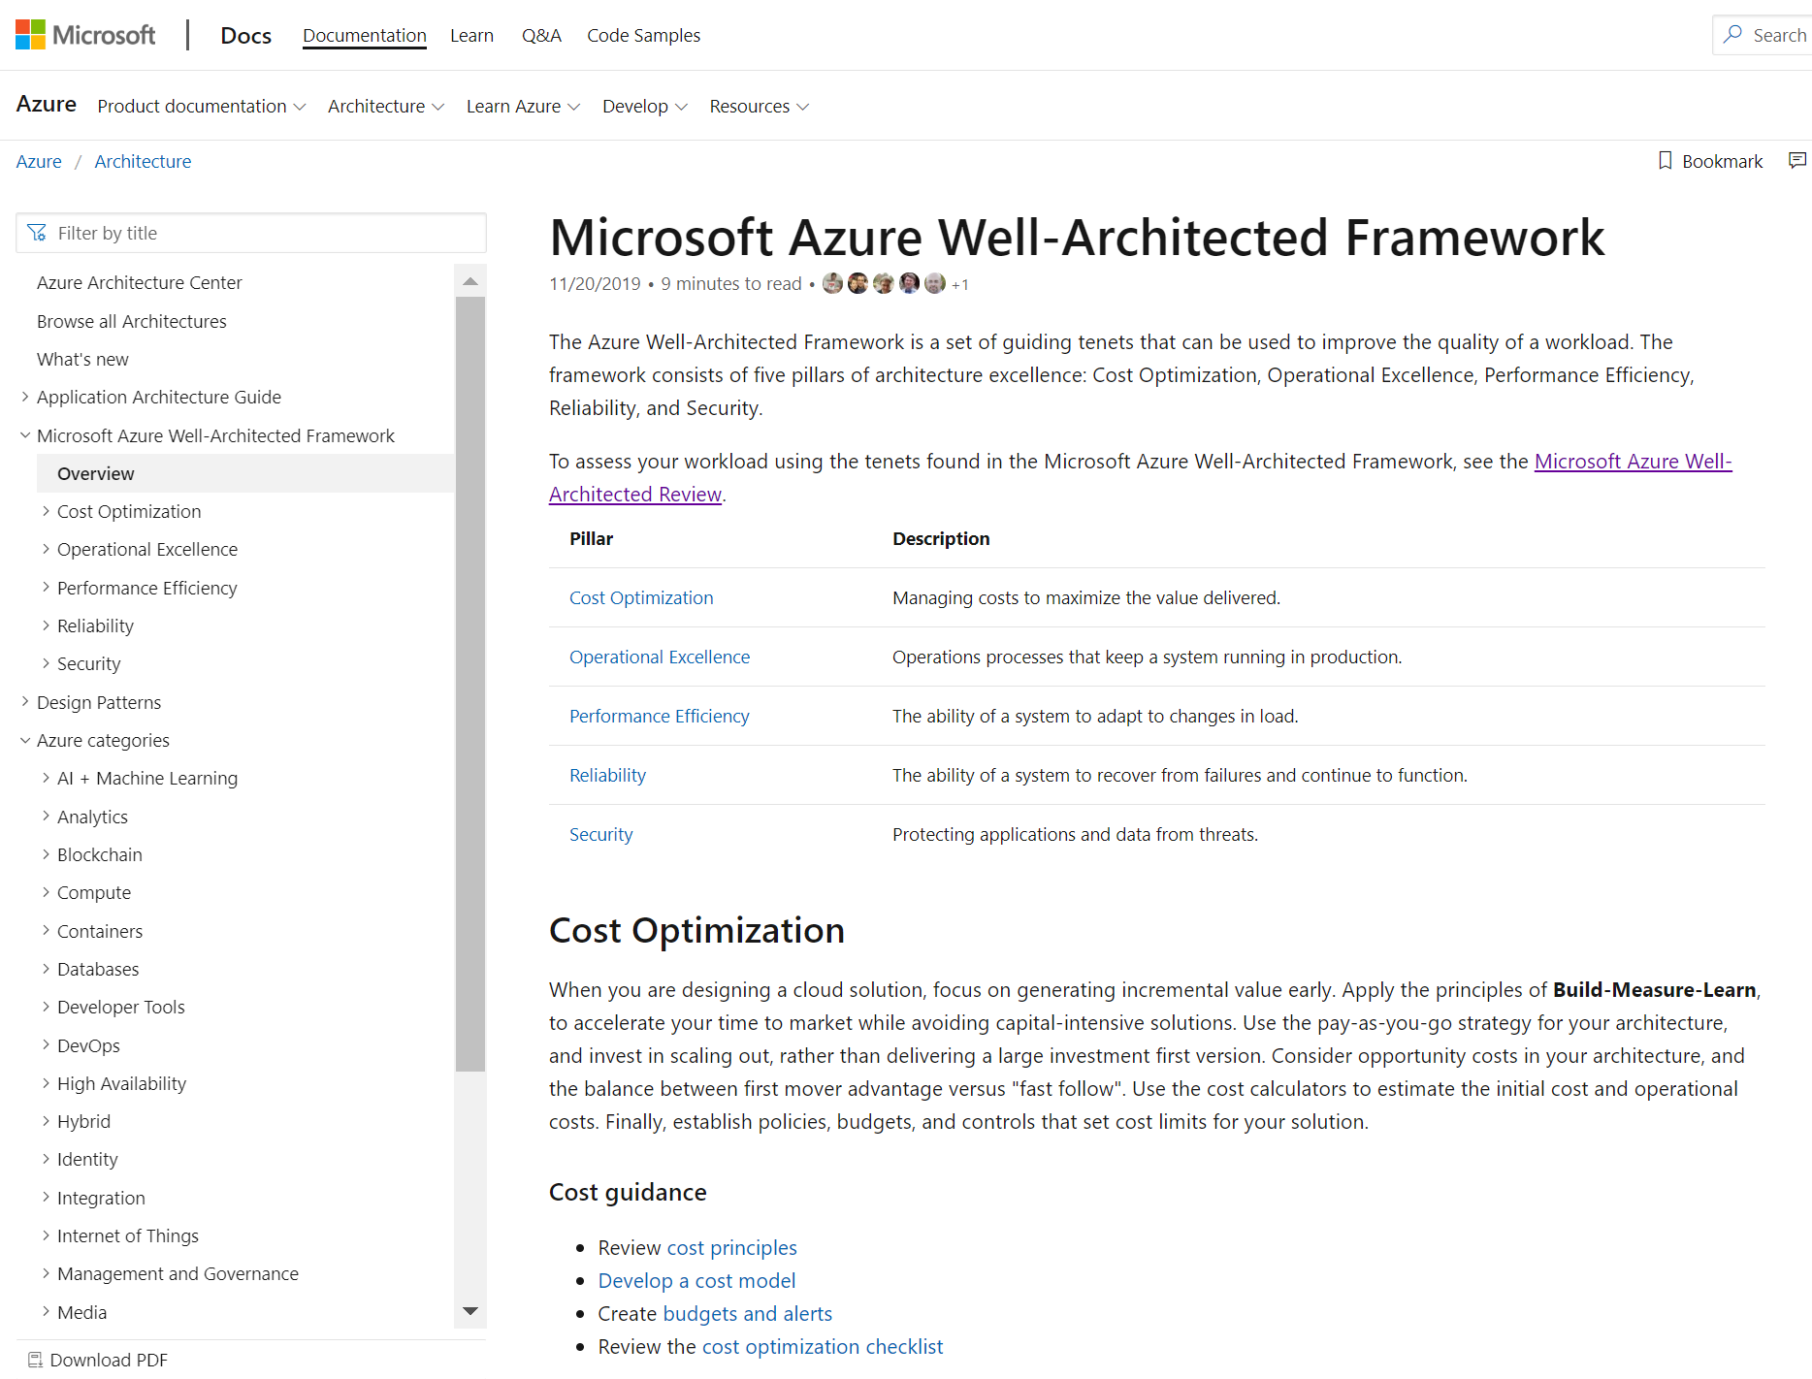
Microsoft Azure Well-Architected Framework
Documentation
https://aka.ms/wellarchitected/framework

Slide 19
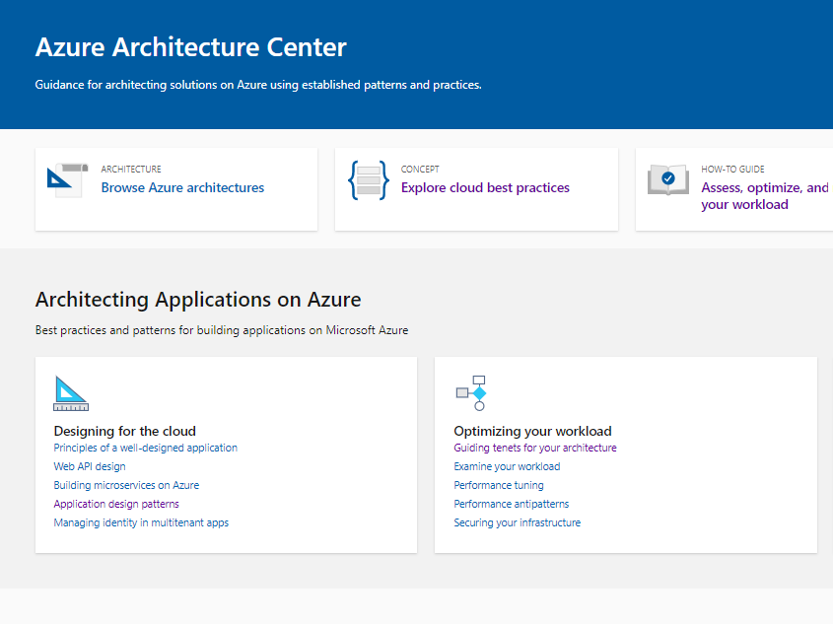
Microsoft Azure Architecture Center
Documentation
https://aka.ms/architecture

Slide 20
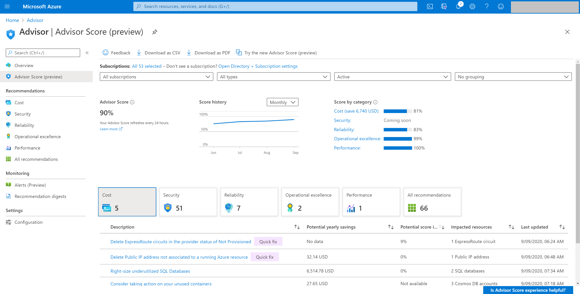
Advisor Score A core feature of Azure Advisor that aggregates recommendations into a simple, actionable score.
Personalized and actionable best practice recommendations, including how to:
Improve the posture of your workloads and optimize your Azure deployments.
Proactively prevent top issues by following best practices.
Assess your Azure workloads against the five pillars of the Microsoft Azure Well-Architected Framework.
Azure.com: aka.ms/advisor
Tool: aka.ms/azureadvisor
Documentation: aka.ms/docs/advisor

Slide 21
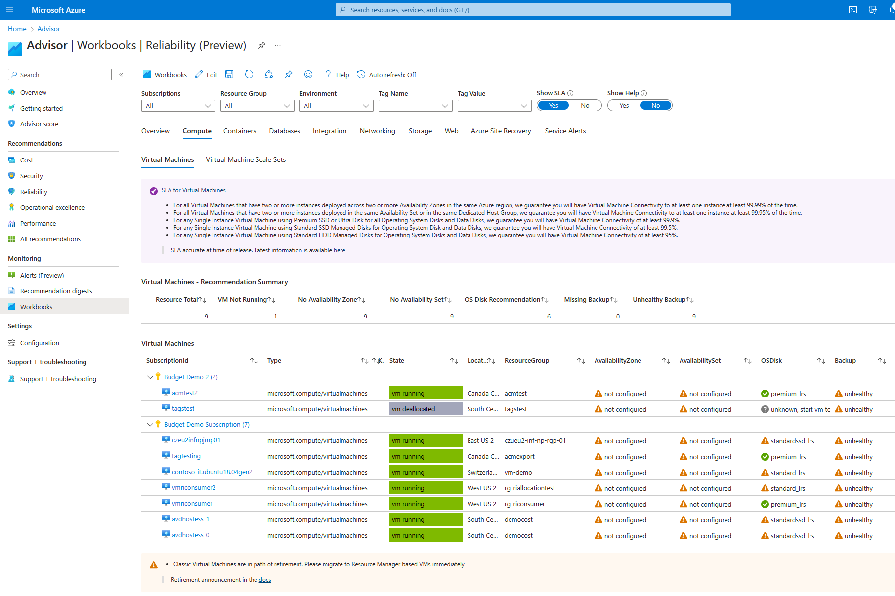
Reliability Workbook You can evaluate the reliability of posture of your applications, assess risks and plan improvements using the new Reliability workbook template, which is available in Azure Advisor.
The workbook offers best practices for Azure services including:
Compute: Virtual Machines, Virtual Machine Scale Sets
Containers: Azure Kubernetes service
Databases: SQL Database, Synapse SQL Pool, Cosmos DB, Azure Database for MySQL, Azure Cache for Redis
Integration: Azure API Management
Networking: Azure Firewall, Azure Front Door & CDN, Application Gateway, Load Balancer, Public IP, VPN & Express Route Gateway
Storage: Storage Account
Web: App Service Plan, App Service, Function App
Azure Site Recovery
Service Alerts
Documentation: https://learn.microsoft.com/en-us/azure/advisor/advisor-how-to-improve-reliability#reliability-workbook

Slide 22
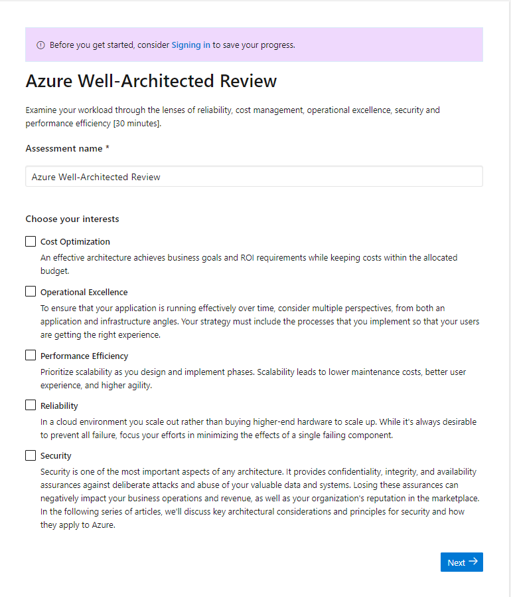
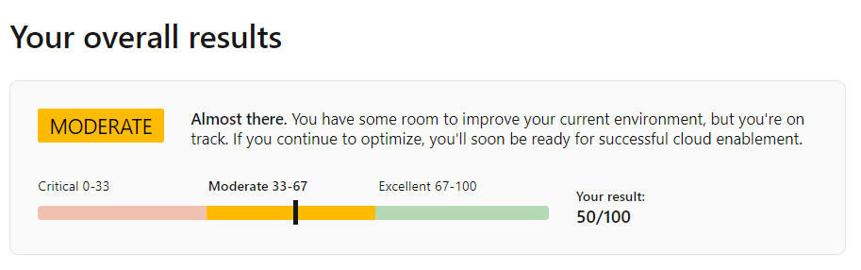
Well-Architected Review Online Tool
Assess your workloads using the tenets found in the Microsoft Azure Well-Architected Framework:
Understand the Well-Architected level of your workload environment.
Access guidance for next steps of your workload improvement process.
aka.ms/wellarchitected/review

Slide 23
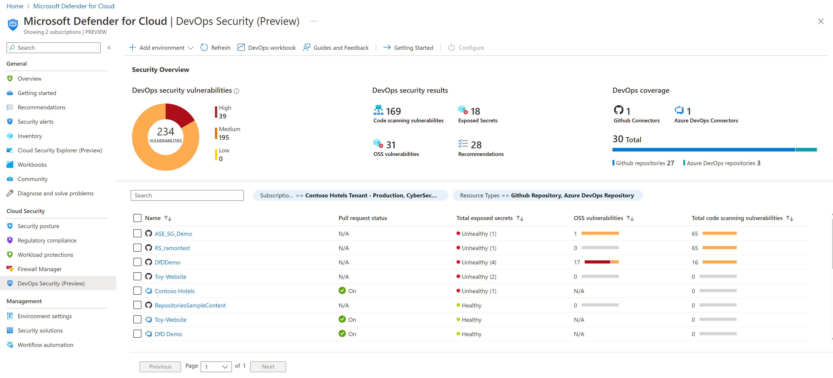
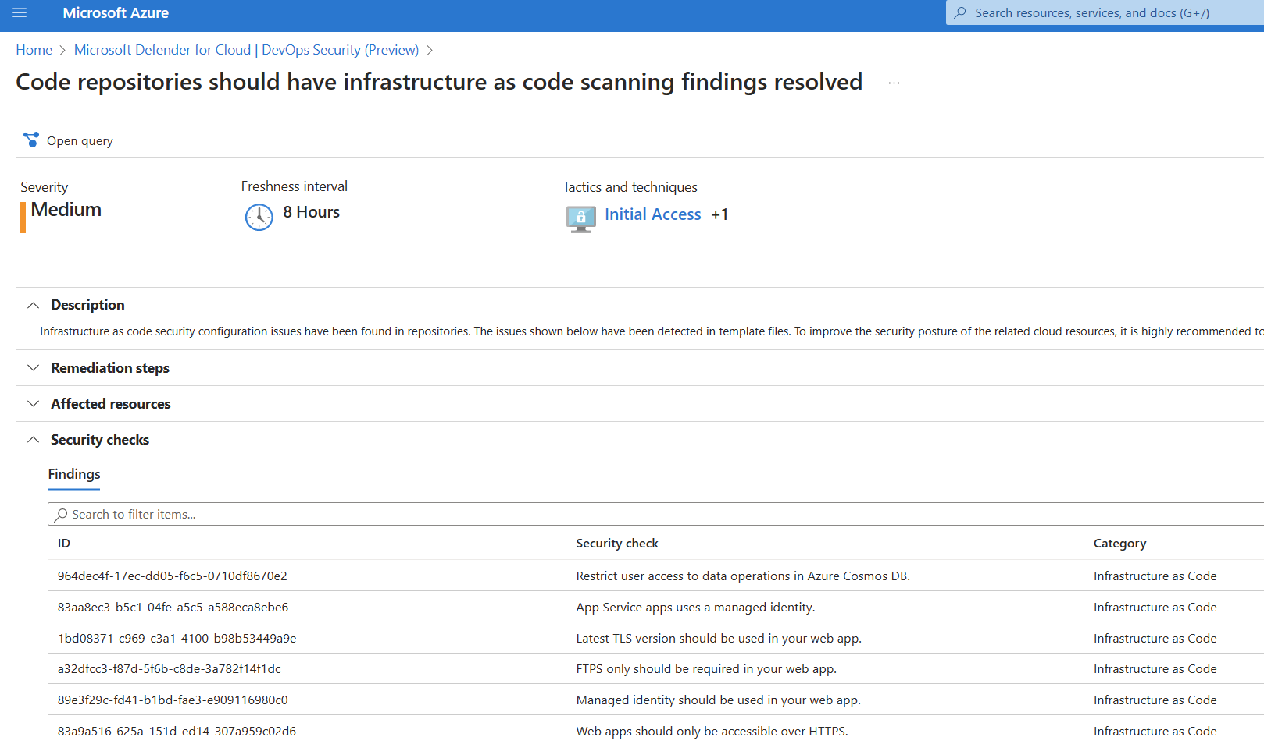
Defender for DevOps Empowers security teams to manage DevOps security across multi-pipeline environments
Defender for DevOps uses a central console to empower security teams with the ability to protect applications and resources from code to cloud across multi-pipeline environments, such as GitHub and Azure DevOps.
Eliminate infrastructure needs with a fully managed service
Unified visibility into DevOps security posture
Strengthen cloud resource configurations throughout the development lifecycle​
Discover misconfigurations in Infrastructure as Code (IaC)
Prioritize remediation of critical issues in code​
Documentation: Microsoft Defender for DevOps

Slide 24
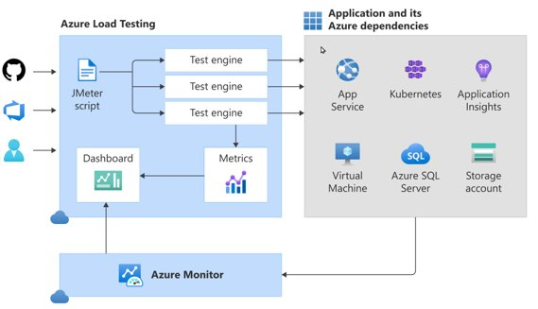
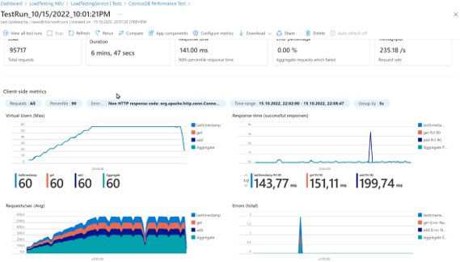
Azure Load Test Generate high-scale load with ease
Generate high-scale loads, identify app performance bottlenecks, and automate regression testing with Azure Load Testing service.
Run JMeter scripts at scale​
Eliminate infrastructure needs with a fully managed service
Generate deep, actionable insights and recommendations​
Understand how tests impact all parts of your app​
Compare across load tests to understand change over time​
Documentation: https://learn.microsoft.com/en-us/azure/load-testing/

Slide 25
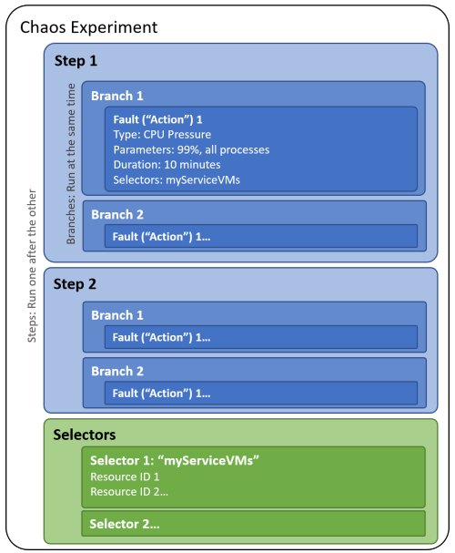
Azure Chaos Studio Measure, understand, improve, and maintain workload resilience​
Fully managed service for building resilience into your Azure services
IaC experiment deployment via ARM
Impact analysis in observability tools with Azure Monitor integration
Expanding library of faults for common Azure service issues
Simulation of real-world scenarios using orchestrated parallel and sequential fault injection
Roll back experiments and grant granular fault permissions with AAD to safeguard against fault injection causing outages
Documentation: https://learn.microsoft.com/en-US/azure/chaos-studio/chaos-studio-overview

Slide 26
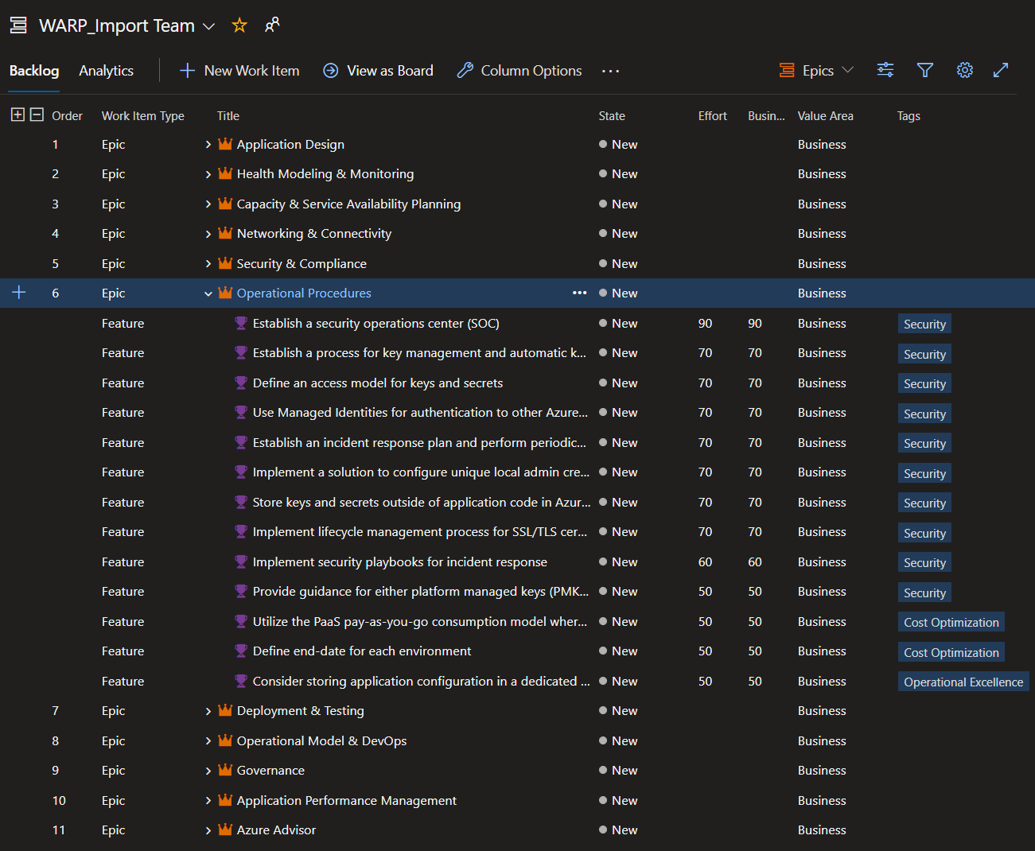
WARP DevOps Tooling for the Well-Architected Recommendation Process
If you're using a DevOps approach for your operational process, Microsoft has provided example scripts that will automate the import of the recommendations from the Well-Architected Review exported CSV into a new Azure DevOps or GitHub project within your existing organization.
Download example import scripts at DevOps Tooling for Well-Architected Recommendation Process.

Slide 27
Tooling Demo

Slide 28
Microsoft Azure Well-Architected
Partner &
Service Offers
Documentation
Azure Well-Architected Review
Cost Optimization
Security
Operational
Excellence
Reliability
Performance Efficiency
Reference
Architectures
Design Principles
Azure Advisor

Slide 29
Questions?

Slide 30
Thank you!

